Slide 1
April 25 , 2016 – State of Politics

Slide 2
Conversation focus…
State of ‘play’ in party presidential nominations
Insider look at Senate and House control
Impact of ‘State of Politics’ on U.S. economy & business climate for the next 2-4 years

Slide 3
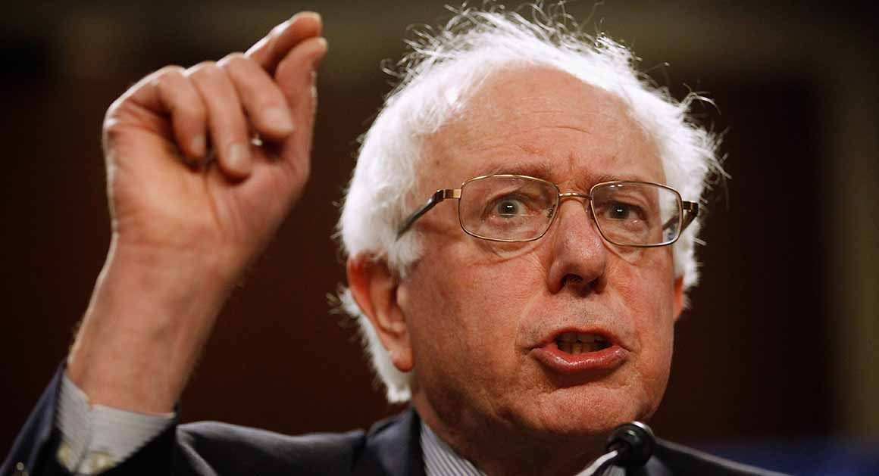
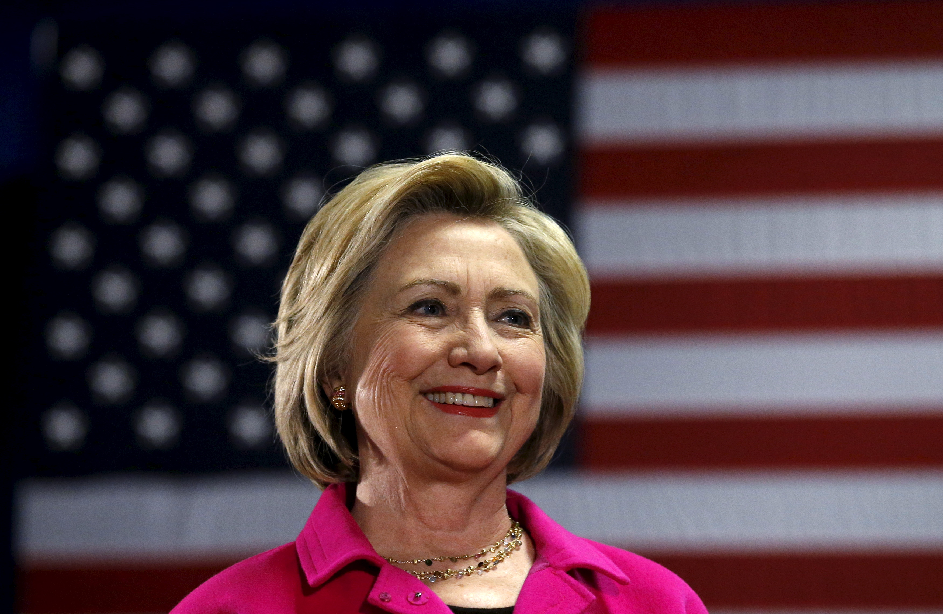
Presidential Nominations
Democratic Party
40%
60%

Slide 4
Favorite Sanders policies…
$19.6 Trillion in new taxes (more than the entire economy in 2015)
Tax coal-powered plants
$15.00 minimum wage
Opposes TPP Agreement
Establish Progressive Death Tax
Tax Capital Gains & Dividends at 39.6%
Single-payer health care

Slide 5
No Sanders’ surprise…
Sen. Sanders registered from Independent Party (Self Described Socialist) to Democratic Party in November 2015….

Slide 7
Favorite Clinton policies…
$1 Trillion in new taxes
$12.00 minimum wage
Opposes TPP Agreement
Enforce Dodd-Frank Act
Tax on high-frequency trading
Keep Affordable Care Act (ACA) in place

Slide 8
Current Delegate Standing
Clinton Sanders
Regular 1,446 1,205
Super 478 40
Total 1,924 1,245
--------
Needed to win: 2,383
Remaining: 1,672 (Clinton only needs 28%)

Slide 9
4 items to watch before Convention…
FBI Investigation of State Department Server (Foundation, etc.)
Clinton “Trustworthiness” indicators
(Independents)
Party attitude toward Sanders/supporters
Increased visibility of Vice President Biden

Slide 10
Democratic Nominee

Slide 11
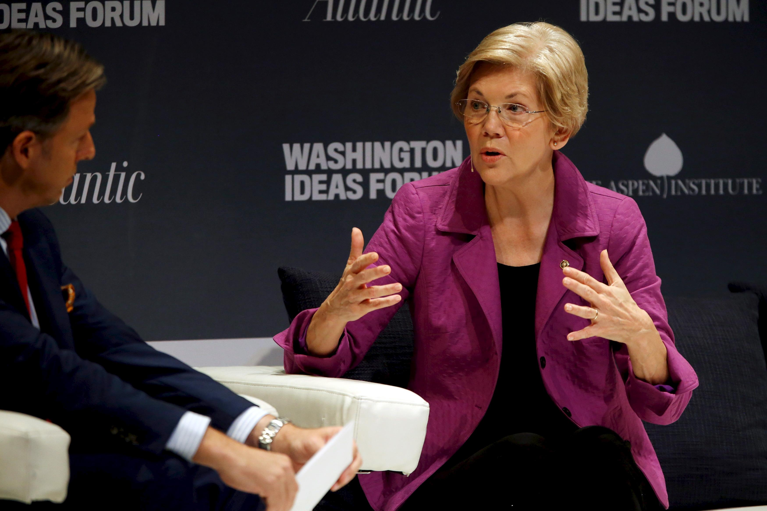
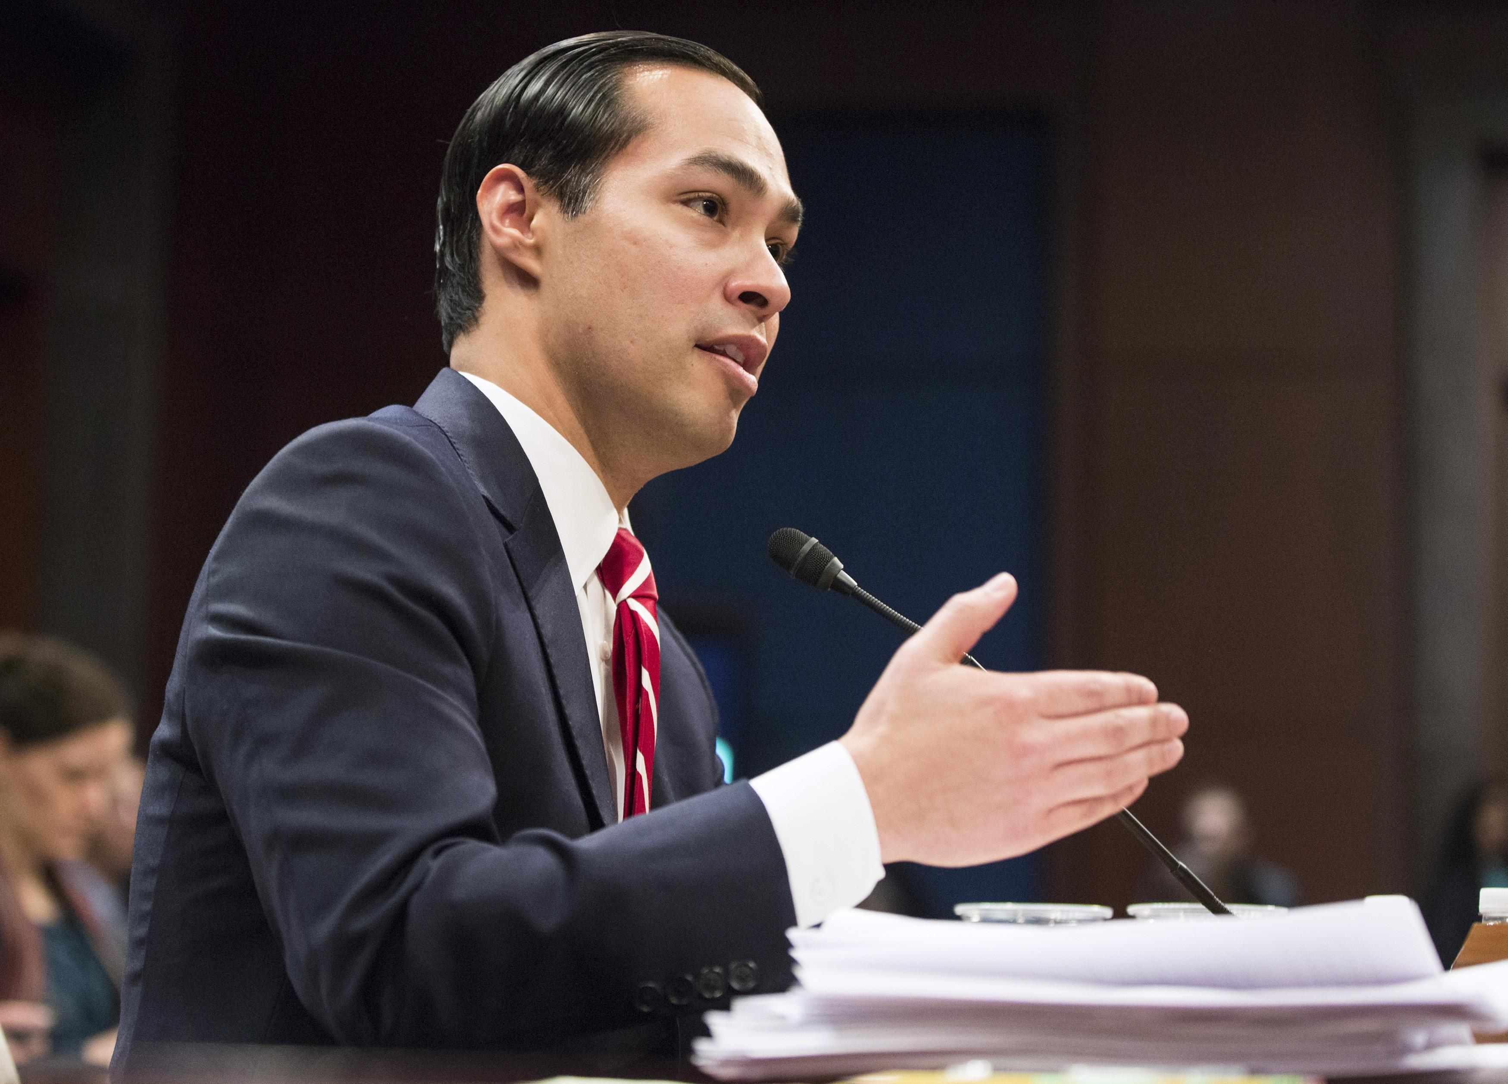
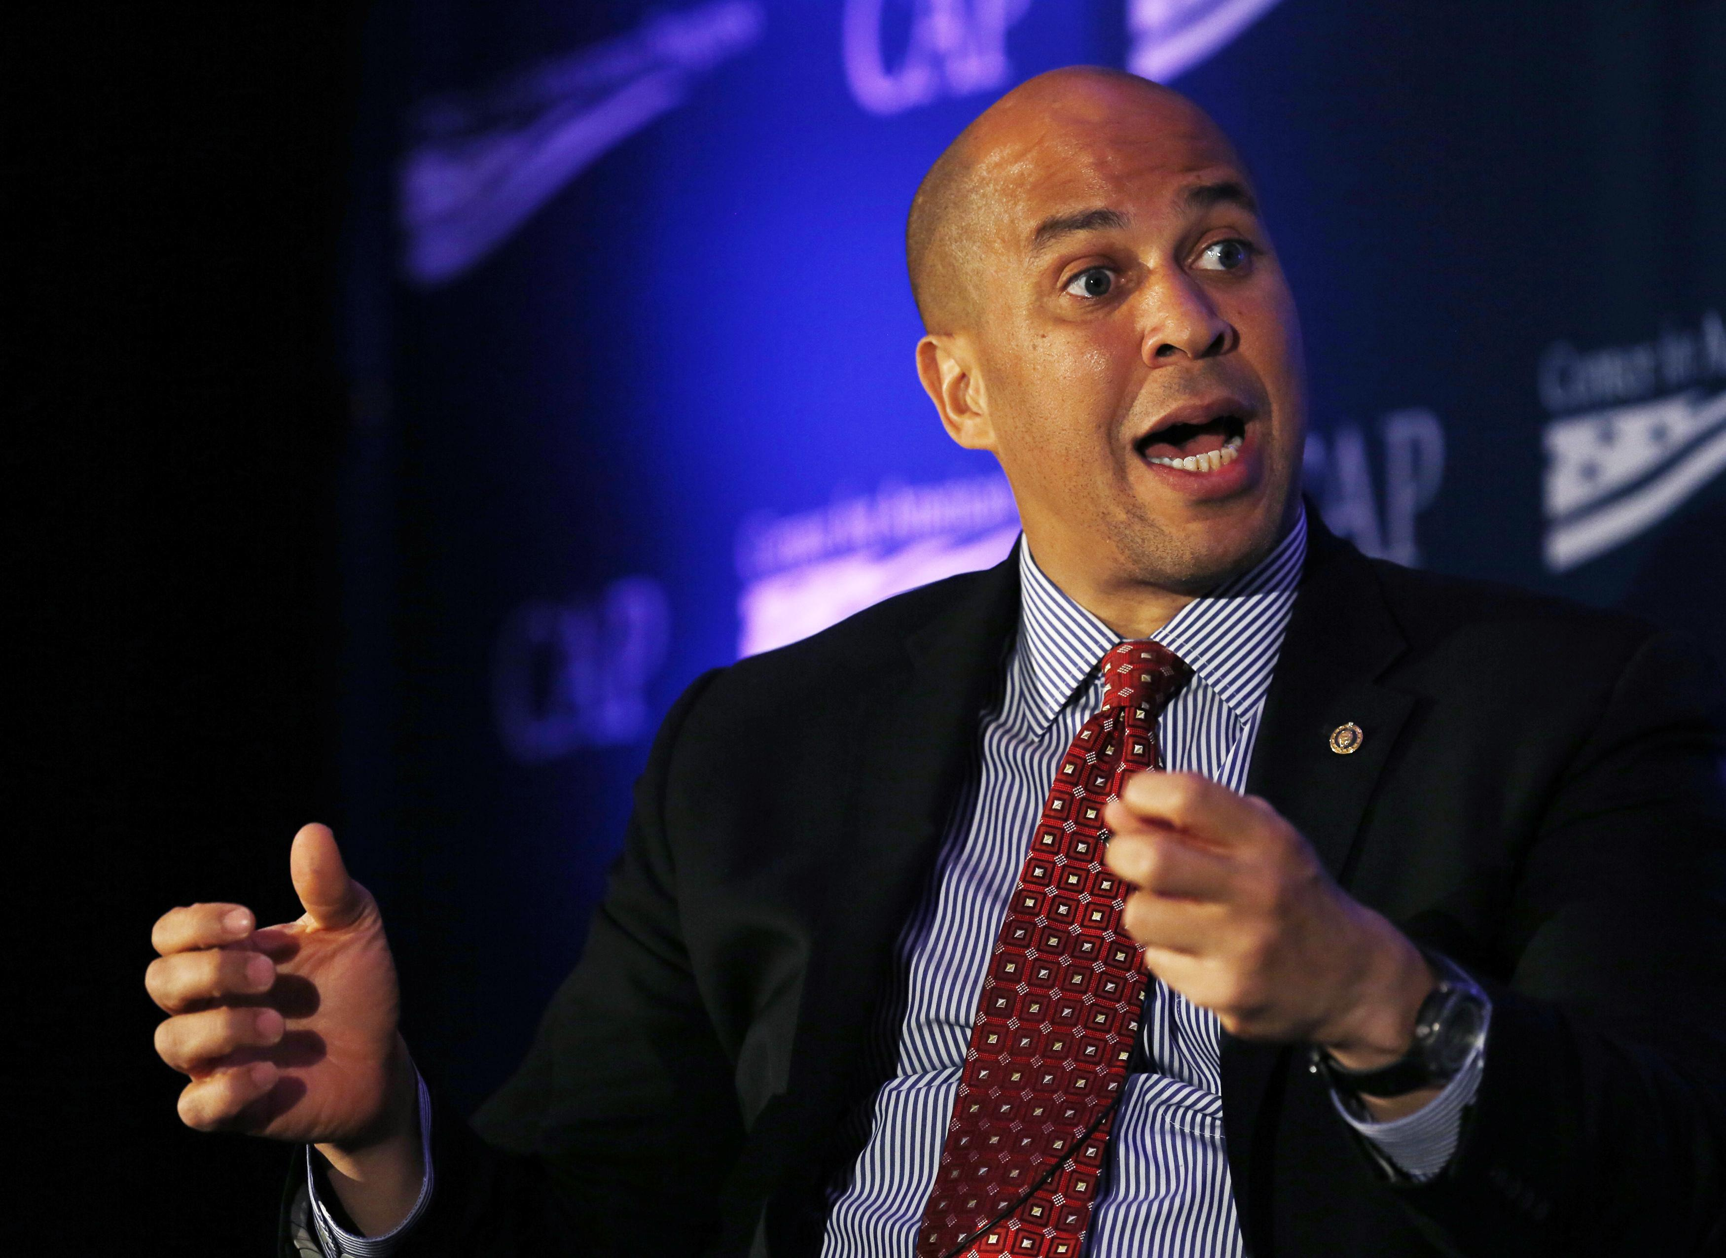
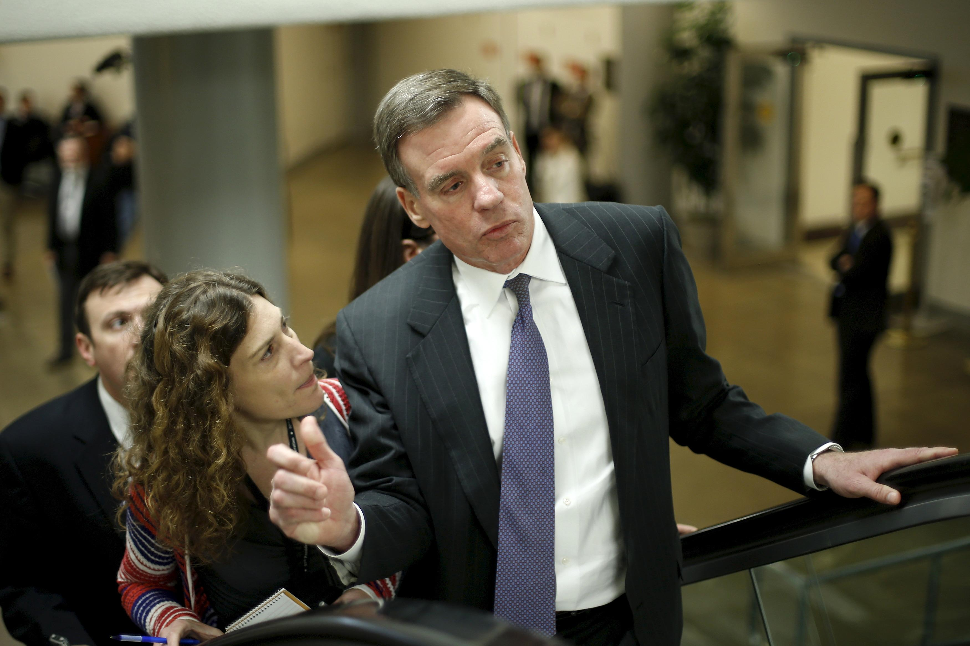
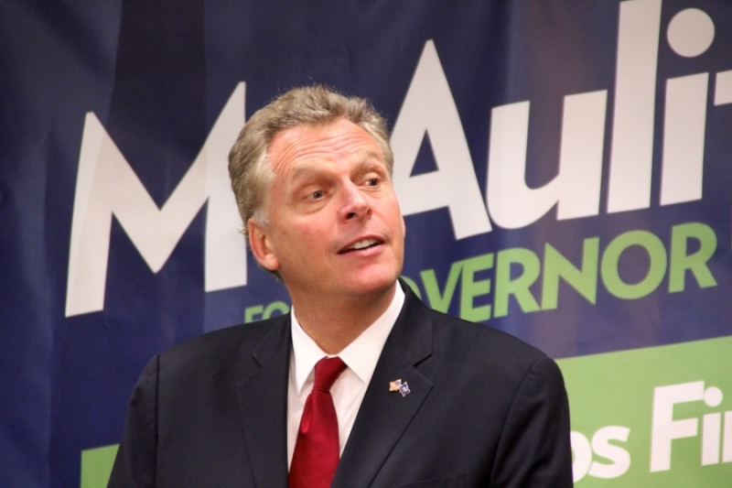
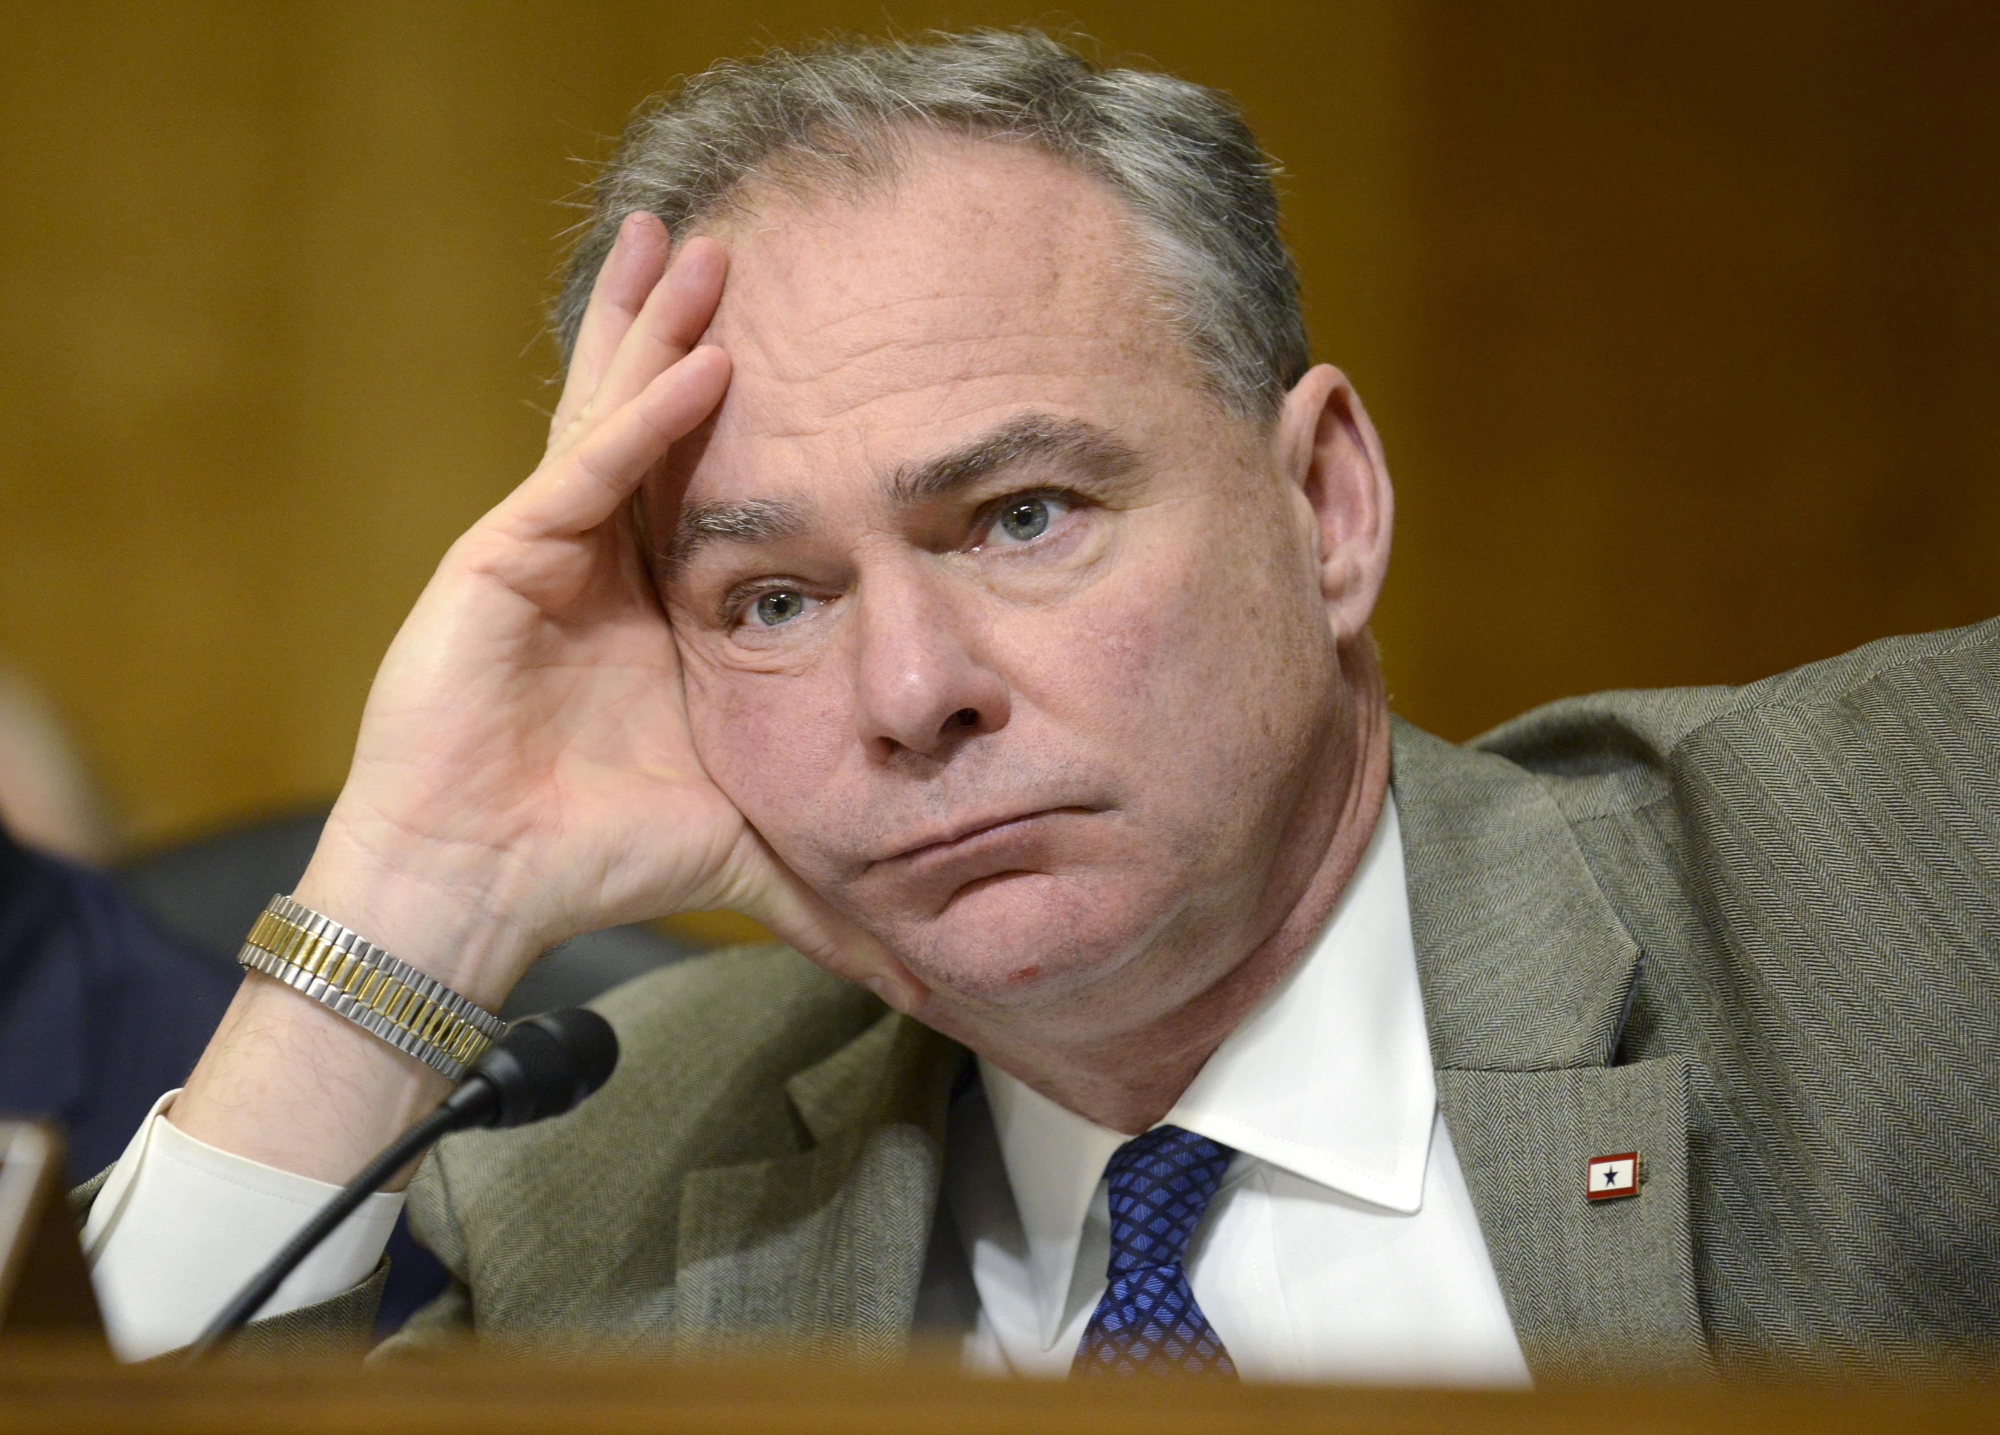
Potential Clinton V-P Choices

Slide 12
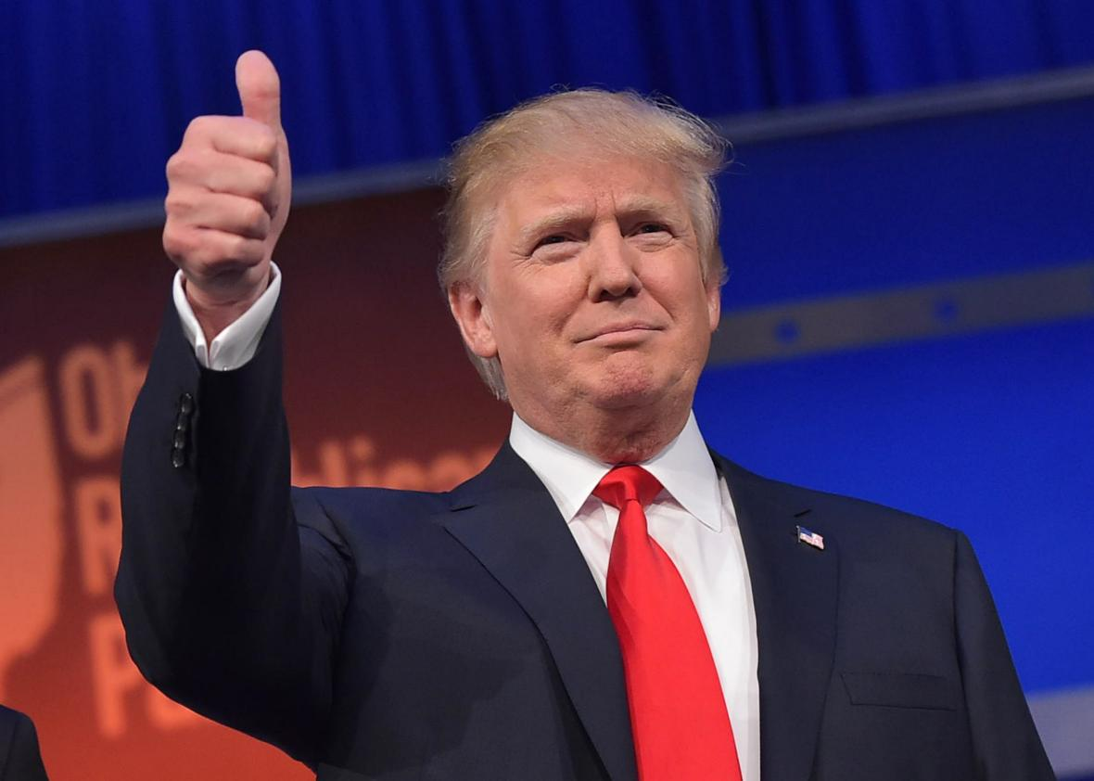
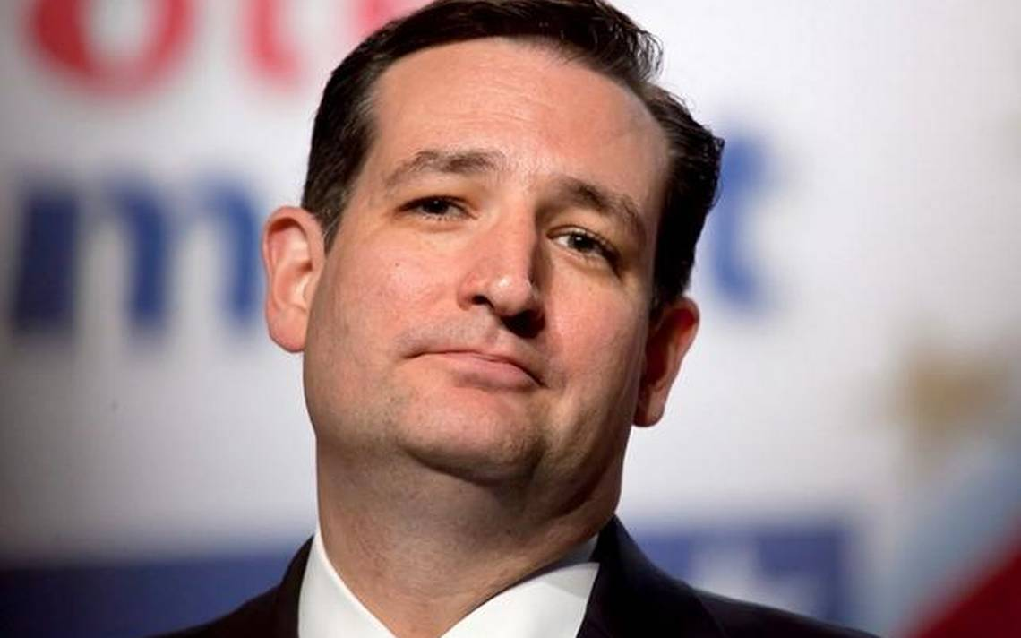
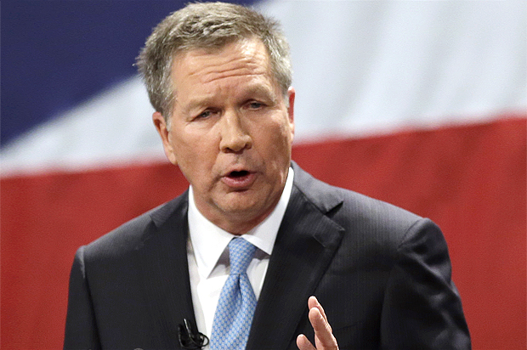
Presidential Nominations
Republican Party
50%
35%
15%

Slide 13
Favorite Policy Positions…
Not really significant differences on policy positions…
Cruz 10% Flat tax (16% for business), eliminating the IRS,
Sparking 5% - 6% economic growth...
Trump tax reform stimuate 4% growth annually...
Kasich wants to balance the budget & cut taxes....
Campaign really focused on personalities

Slide 14
Current Delegate Standing
Candidate Estimated Count
Trump 847
Cruz 559
Kasich 149
Rubio 173
Others 16
Uncommitted 98
--------
Needed to win: 1,237
Remaining: 674 (Trump needs 57% - 15 states)

Slide 15
Trump Strategy
Create momentum of inevitability…
Pick up ‘Establishment’ endorsements
Act more ‘Presidential’ without alienating Trump base
Court delegates with Trump enterprise assets
“Internal campaign memo projects Trump will win 1,400 delegates at GOP convention”

Slide 16
Cruz Strategy
Win Western conservative states…(block Trump gains)
Pick up ‘Establishment’ endorsements
Use strong campaign organization to get delegate commitments
Point out ‘down ballot’ damage if Trump is the nominee (U.S. Senate/U.S. House could go Democrat)
Keep Cruz activists ‘fired up’ so they don’t give up (Trump is no conservative and will be deal-maker)
Get to second ballot at Cleveland Convention

Slide 17
Kasich Strategy
Come in ahead of Cruz in Northeastern/Midwestern States
Keep campaign coffers filled
Keep sole focus on polls which show he is the only person who consistently beats Hillary Clinton
Kasich launched “1237 Project” to push for contested convention
Pack Cleveland with 30,000 ‘hometown’ supporters

Slide 18
Republican Nominee

Slide 19
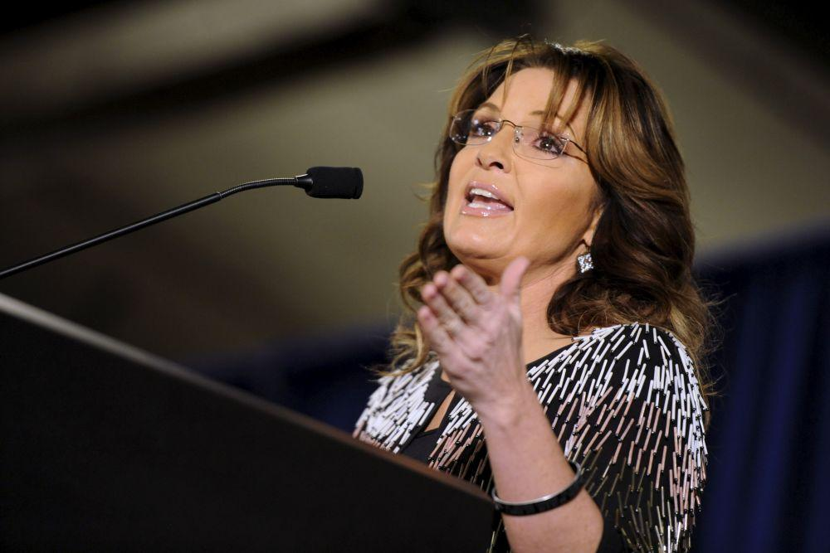
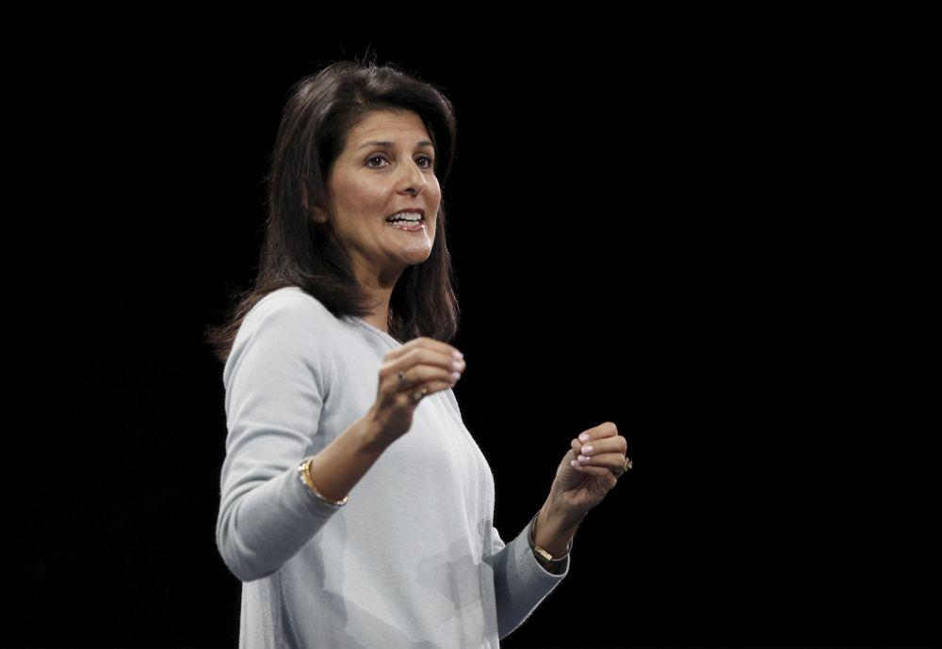
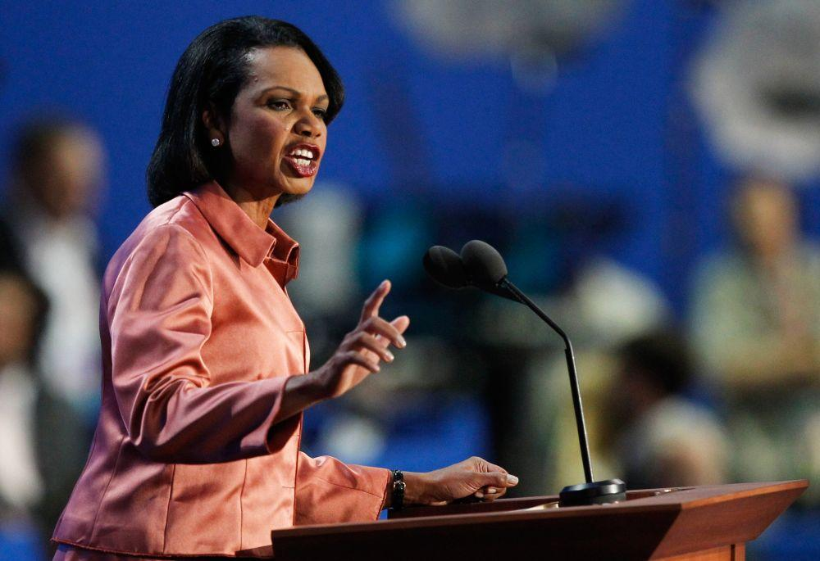
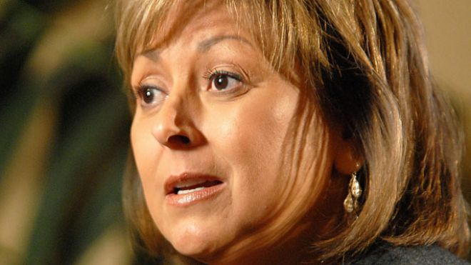
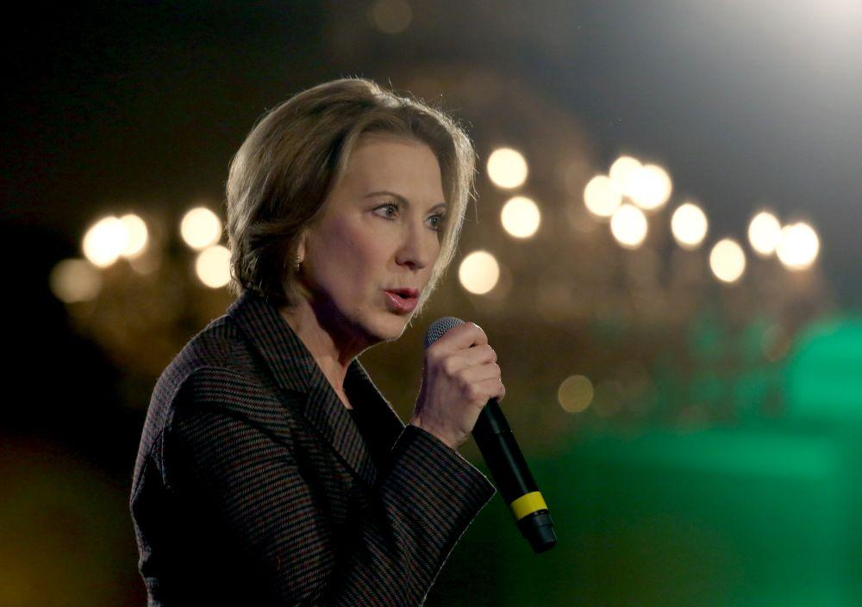
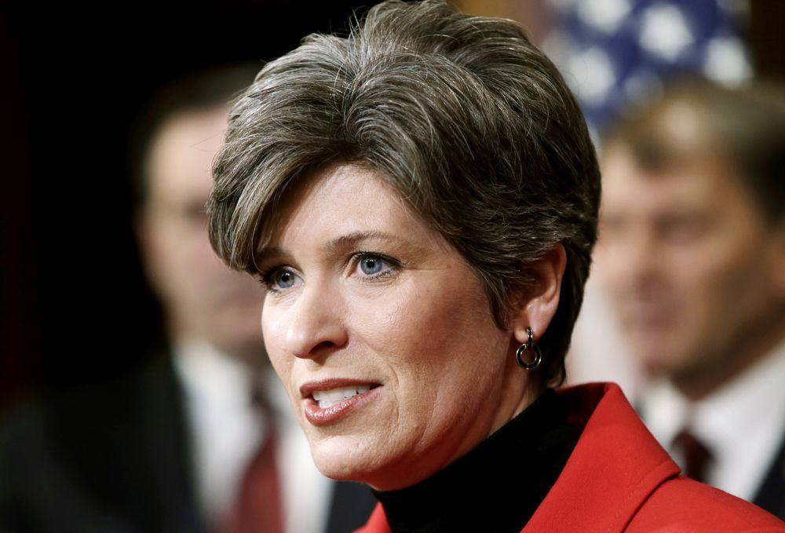
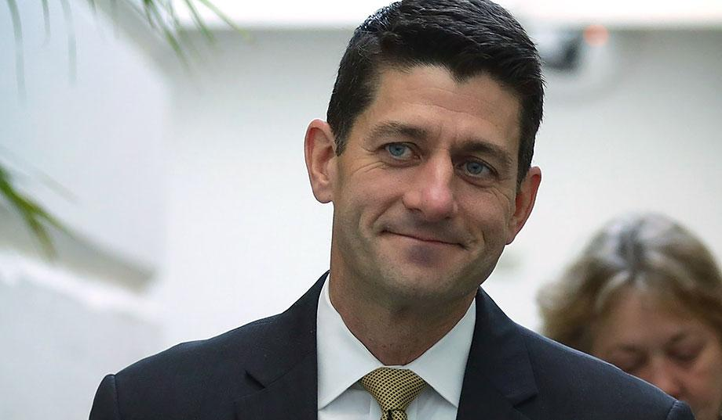
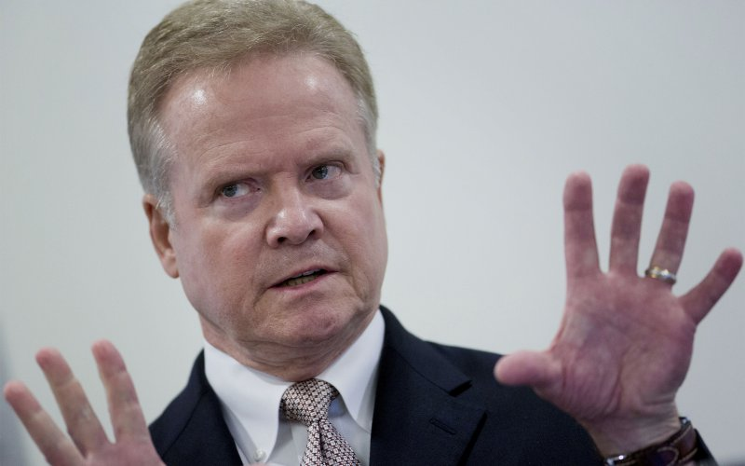
Potential Trump V-P Choices

Slide 20
General Election Battle
Economic Growth & Jobs
Security (Terrorist Threat)
Turnout of the base
Wave Election (Last 72 hours…)

Slide 21
U.S. Senate
54 GOP/45 Dems/1 Independent (caucus with Dems)
Democrats need 4-5 seat pick-up to win control
Endangered Republican Seats:
IL - Kirk
FL - Open
WI - Johnson
NH - Ayotte
PA - Toomey
OH - Portman
Endangered Democratic Seats:
NV - Open

Slide 22
U.S. House
Solid 204 175
Likely/Lean 24 9
--------------- 228 184
Toss Up/Worse 19 4
________________________________
248 188

Slide 23
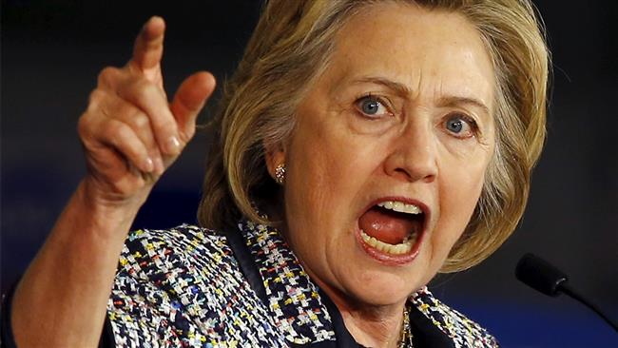
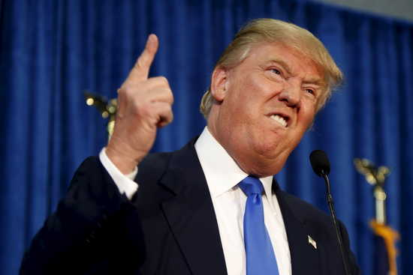
As the campaign draws closer…
Take polls with a grain of salt – most Americans make decision 72 hours before Election Day
Enthusiasm Gap +44 (GOP); +21 (Democrats)
Post convention narratives make a big difference

Slide 24
Implications for Business
Focus greater energy on accountability of the Administrative State
Legislative process will still be lethargic
If GOP wins, need 90-120 day strategic action plan to set ‘growth’ in motion
If Clinton wins, we need to ‘tie up’ agencies and use appropriation funding riders to not impose costs on business community
If Clinton wins and Dems control Congress, bad days ahead for ‘Free Enterprise’

Slide 25
Thank you…Questions?

